Slide 1
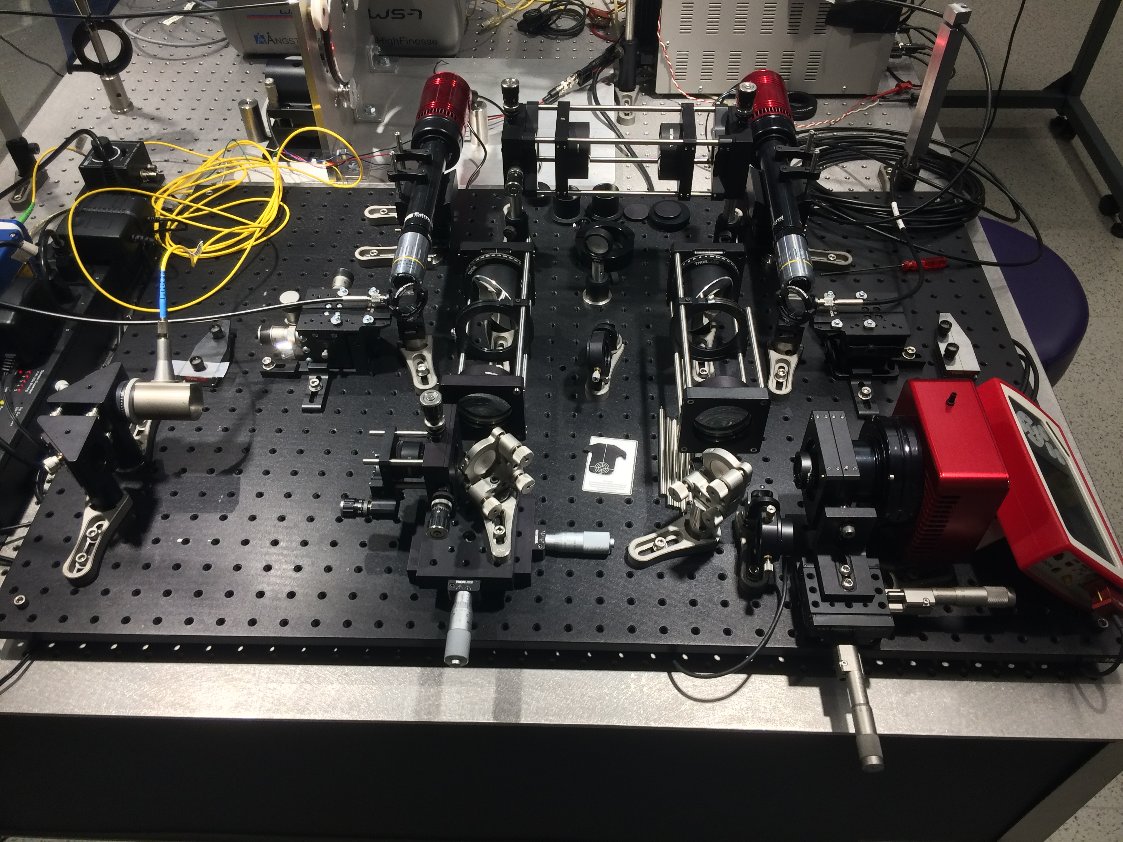
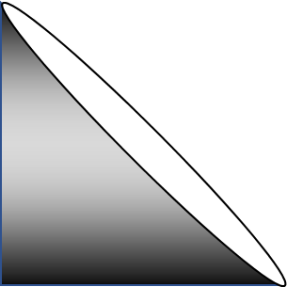
Agitation
Selection
Input
Near Field
10x
10x
Light Source Selection
Far Field

Slide 3
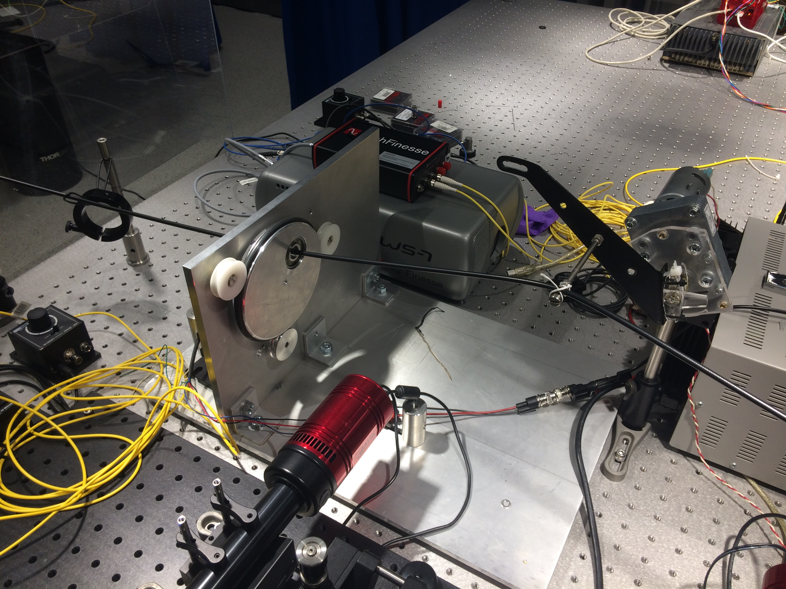
Counterweight
Circular Agitator
Linear Agitator

